Slide 1
觸控展與專利
開發員 : 余祥文

Slide 2
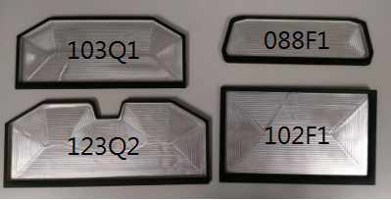
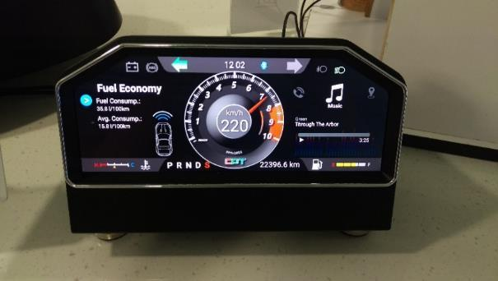
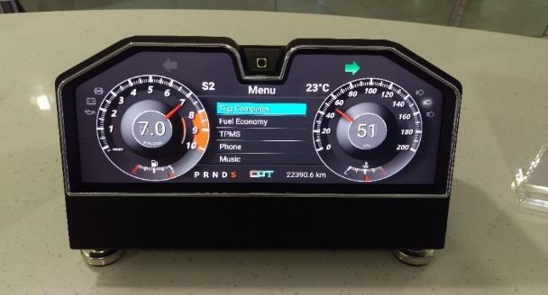
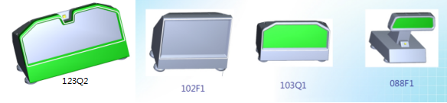
2018 智慧顯示展 負責 展品

Slide 3
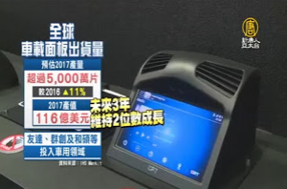
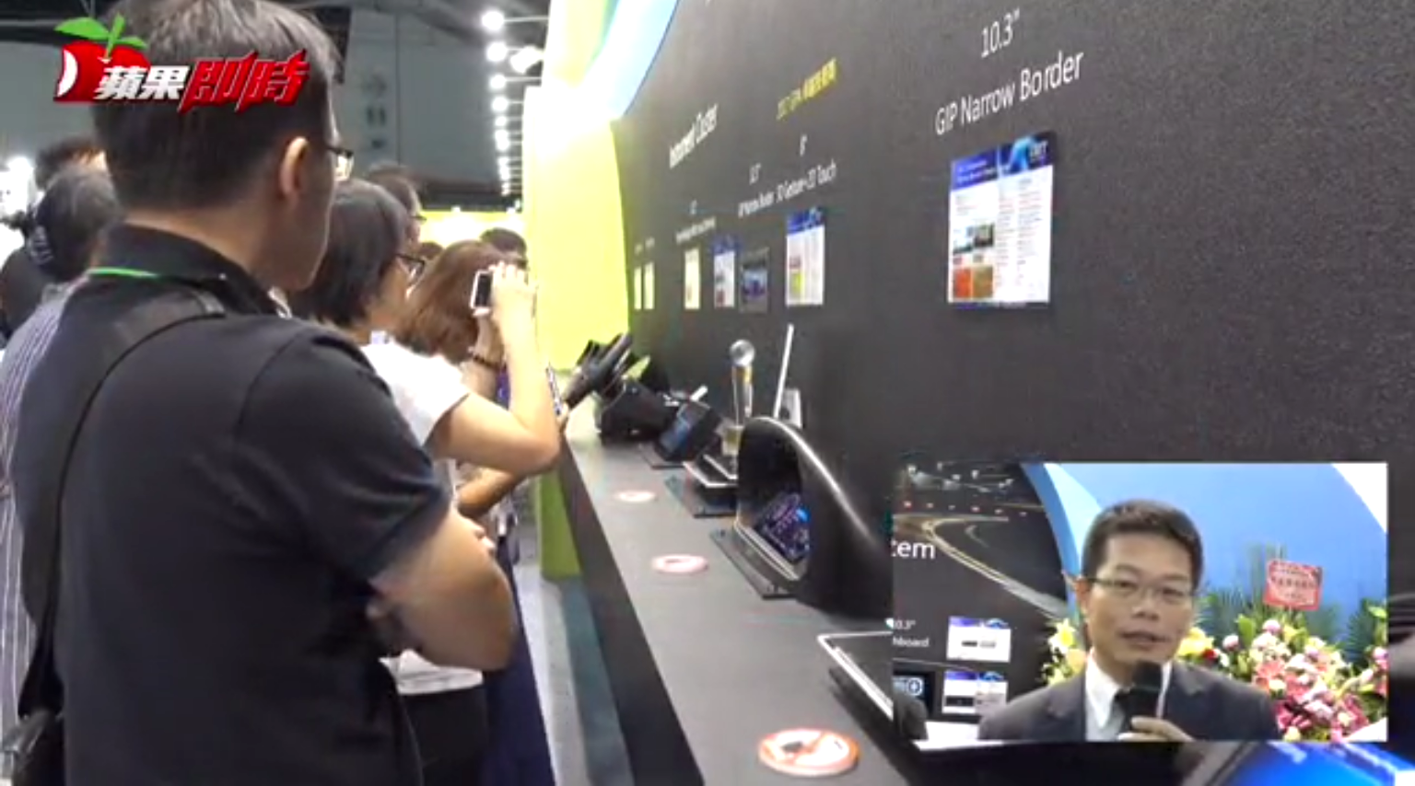
2017 智慧顯示展 負責 展品

Slide 4
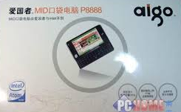
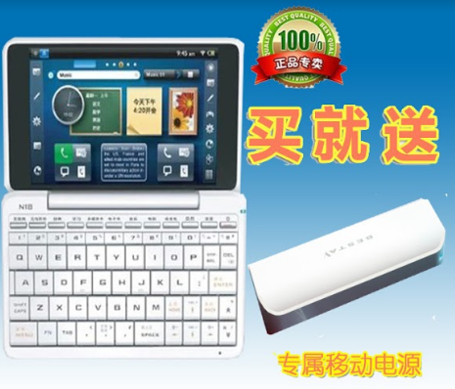
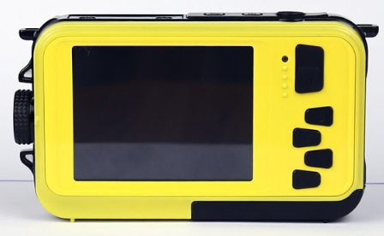
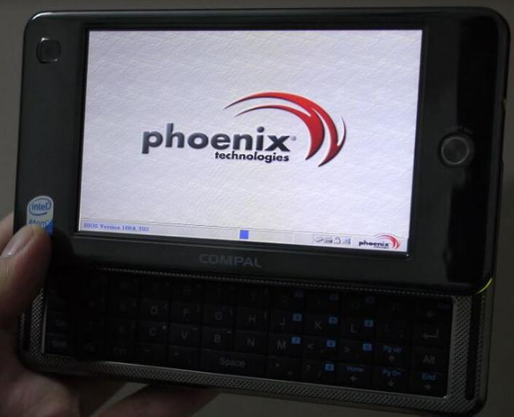
其他產品
2009 愛國者MID P8888
2010 - 2.7inch TFT Digital Camera_samsung
2009 譯典通N18安卓牛津詞典4.8高清屏 英業達
2008仁寶 4.8 win xp

Slide 5
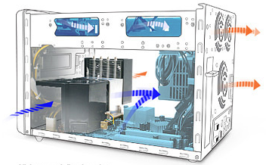
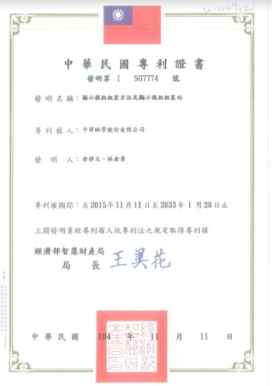
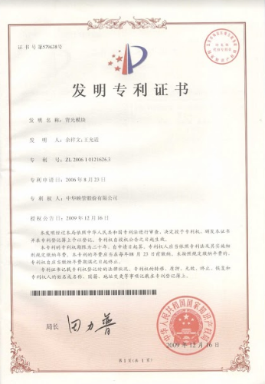
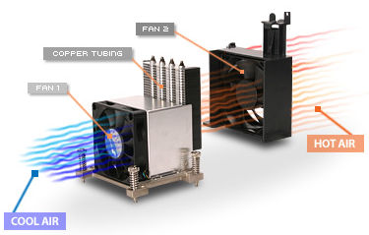
其他產品
專利
浩鑫電腦 產品 - 準系統 XPC

Slide 6
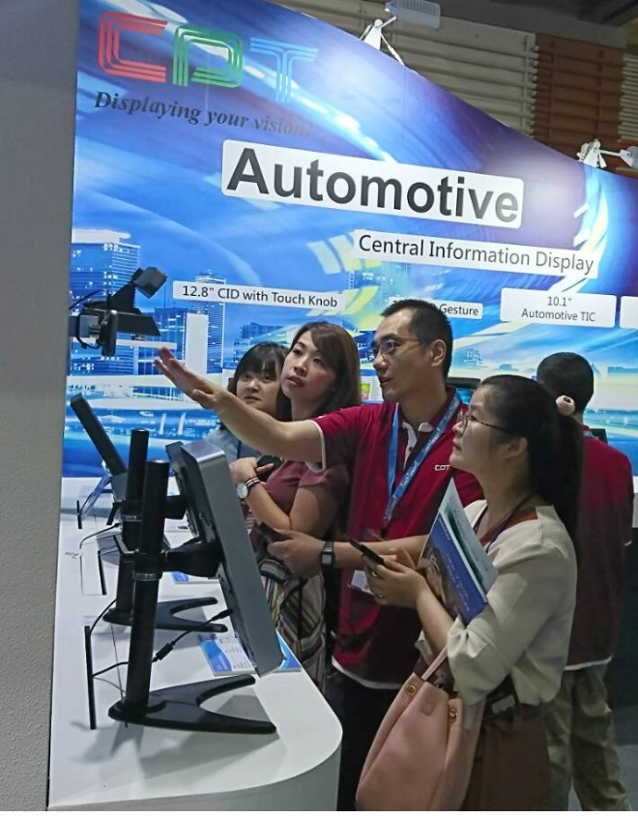
感謝
Cooperation is Power
KEY 1: Make a commitment to go together.
KEY 2: A trip of thousands miles starts with the first step… so is cooperation.
KEY 3: While you walk, be open and share.
KEY 4: Walking together… needs organization.
KEY 5: The walk has difficult moments… Be there for each other…
KEY 6: In critical moments, know your values…
KEY 7: …and don’t forget to laugh and enjoy the moment.

